Slide 1
Welcome to our class

Slide 2
Content
01
Warm-up
02
New words
03
B3 Read
04
Review

Slide 3
PART 01
WARM-UP

Slide 4
Guessing word:
R E C E S S
- - - - - - (6 letters)
Students usually eat and drink.
Some girls often skip rope.
Some boys play catch.
What do you usually do at recess?
What time does your recess start?
How long does it last?

Slide 5
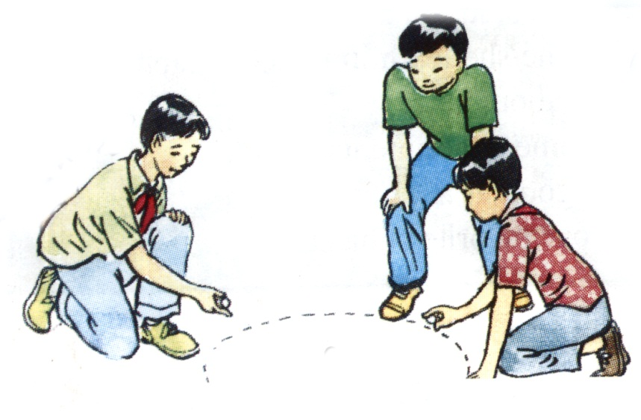
What are they doing ?
They are playing marbles.

Slide 6
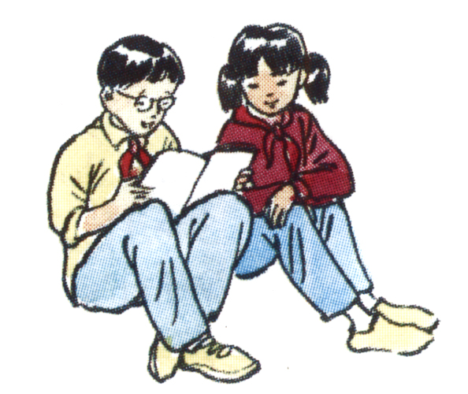
What are they doing ?
They are reading books.

Slide 7
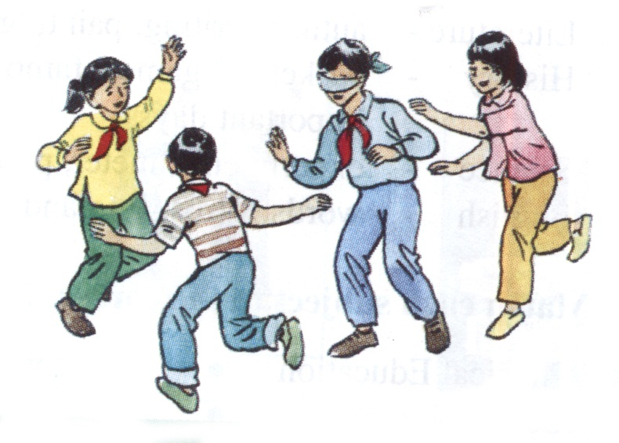
What are they doing ?
They are playing blindman’s bluff.

Slide 8
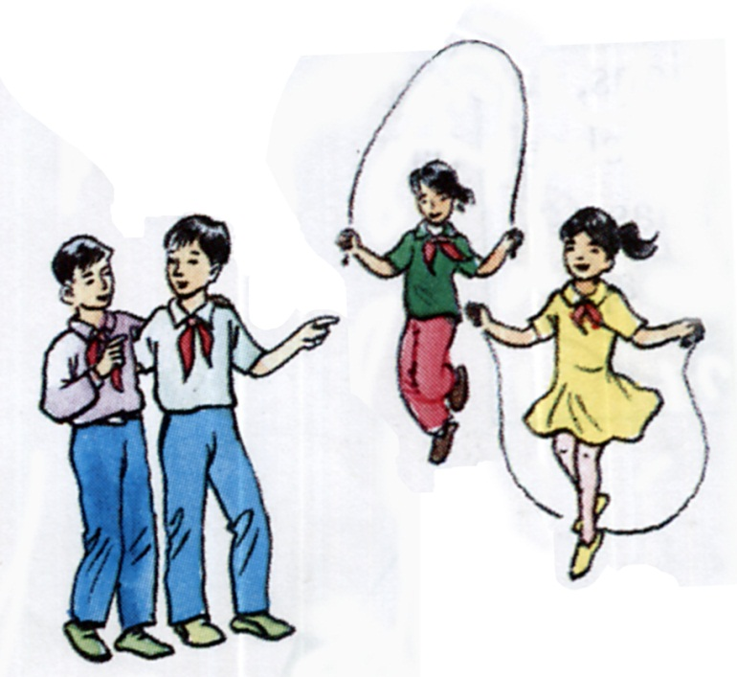
What are they doing ?
The boys are talking and the girls are skipping.

Slide 9
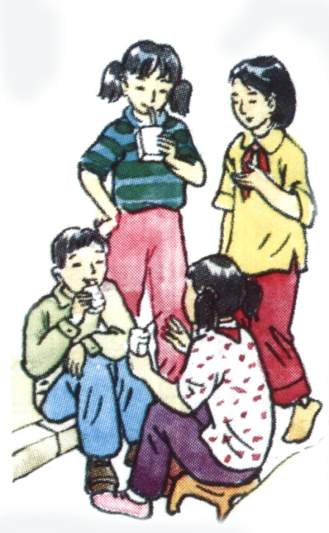
What are they doing ?
They are eating and drinking.

Slide 10
NEW WORDS
PART 02

Slide 11
Unit 5 WORK AND PLAY
Part B It’s time for reccess
Lesson 5 B3 – Read

Slide 12
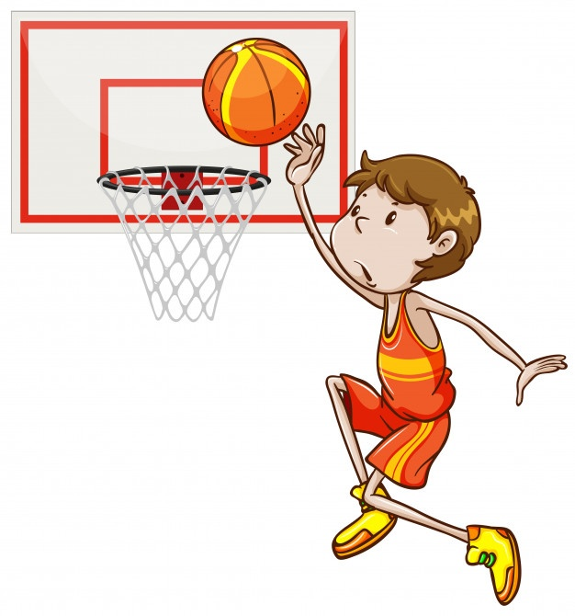
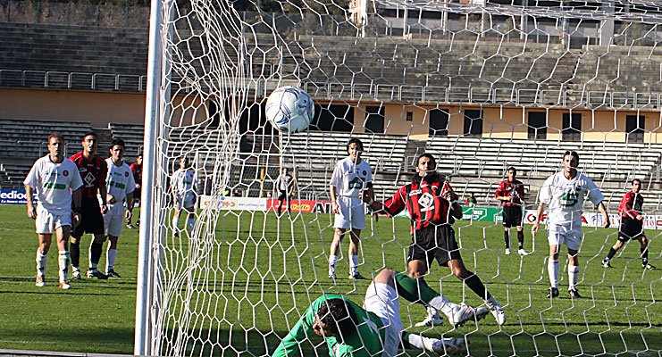
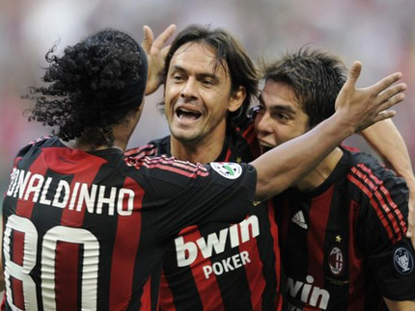
New words
- world wide
khắp thế giới
- energetic (adj)
hiếu động
- score a goal (v)
ghi bàn thắng (trong thể thao)
- shooting some hoops (v)
ném bóng vào rổ
- swap (v)
trao đổi
- baseball card (n)
thẻ bóng chày

Slide 13
Match the words in English with the words in Vietnamese
1. energetic students
2. baseball card
3. score a goal
4. shooting some hoops
5. swap
6. world wide
a. khắp thế giới
b. đưa bóng vào rổ
c. thẻ bóng chày
d. trao đổi
e. ghi bàn thắng
f. những hs năng động

Slide 14
PART 03
Read

Slide 15
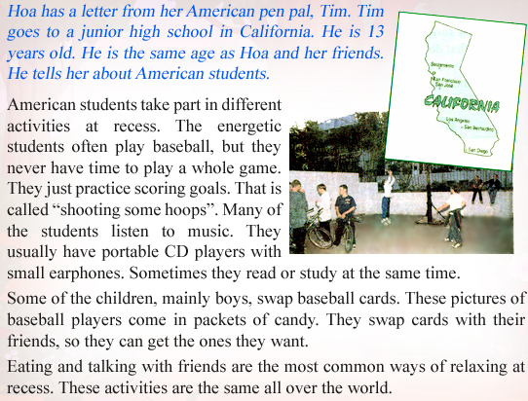
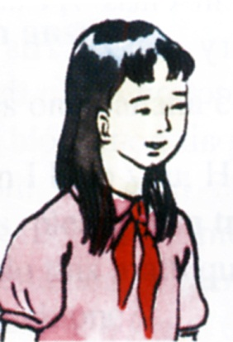
Read
Hoa

Slide 16
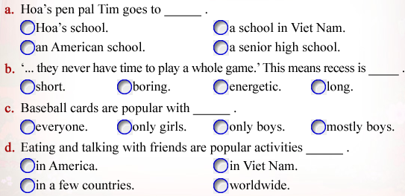
Choose the best answer

Slide 17
read and then complete sentences
Hoa has a letter from her Amercan pen pal, Tim.
Tim goes to a junior high school in California.
He is 13 years old. He is the same age Hoa and her friends.
a. Hoa’s pen pal Tim goes to
A. Hoa’s school
B. a school in Viet Nam
C. an American school
D. a senior high school

Slide 18
read and then complete sentences
American students take part in different activities at recess. The energetic students often play basketball, but they never have time to play a whole game. They just practice scoring goals. That is called “shooting some hoops”
b. “They never have time to play a whole game”. This means recess is
A. short
B. boring
C. energetic
D. long

Slide 19
read and then complete sentences
Some of the children, mainly boys, swap baseball cards. These pictures of baseball players come in packets of candy. They swap cards with their friends, so they can get the ones they want.
c. Baseball cards are popular with
A. everyone
B. only girls
C. only boys
D. mostly boys

Slide 20
read and then complete sentences
Eating and talking with friends are the most common ways of relaxing at recess.
These activities are the same all over the world.
d. Eating and talking with friends are popular activities
A. in America
B. in Viet Nam
C. in a few countries
D. worldwide

Slide 21
Choose the best answer

Slide 22
PART 04
REVEW

Slide 23
Mindmap

Slide 25
HOMEWORK
Learn by heart new words.
Read the passage B3 : 3 times
Prepare : Unit 6 - Part 1- Lesson 1: A1

Slide 26
THANK YOU!

